Slide 1
Flying Squirrel
Jonathan Avila, Ryan Donnellan, Justin Joy, Owen Kehl, Joey Mathews

Slide 2
PHOTO
Project Description
SPONSOR
Dr. Razavian
Raz Labs
CUSTOMER NEEDS
Therapeutic stroke patient device
Table-top cable-driven robot
At home, easy and fast to setup, inexpensive
Less than $1000
Less than 1 minute for setup
Next generation of "Hamster"
Improved from 2D movement to 3D
Smaller in size
Notes:
Show that the need is there and give impactful statements on why it is a problem. Give statistics on these problems. Patient population and why they would use it.

Slide 3
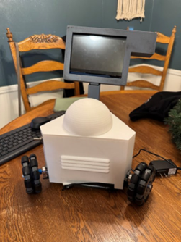
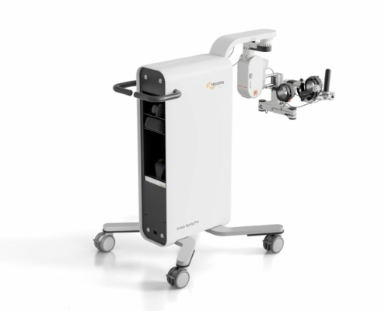
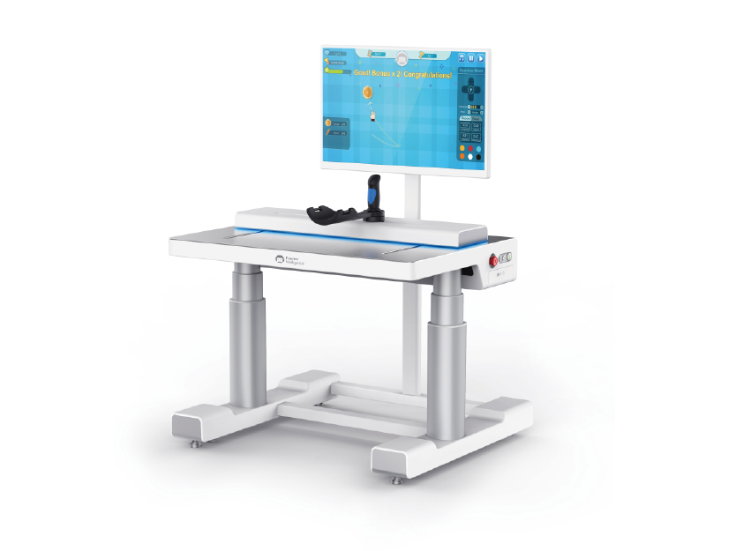
Background & Benchmarking
Armeo SpringPro
ArmMotus M2 Pro
The Hamster
Image 1: Armeo SpringPro
Image 2: ArmMotus M2 Pro
Image 3: The Hamster
Works in x,y,z planes
Full arm support
Large footprint
Complex 3D motion
Very expensive
Works in x,y,z planes
Forearm support
Very large footprint
Simple 3D motion
Very expensive
Works in x,y planes
No arm support
Compact footprint
Simple 2D motion
Inexpensive

Slide 4
Customer Requirements
Client Specified Requirements
Affordable
Smaller size for storage
Lifting mechanism
Simple and efficient setup
Movement using wires
Able to track position and force
No movement when winch motors are locked
Capable to add force sensors
Screen Interface

Slide 5
Engineering Requirements
Functional Requirements
Technical Requirement Targets
Production cost
Speed of the robot
Amount of force the robot needs to be able withstand
Accurate position tracking
Device needs to be relatively small for practical use and storage
The finished cost should not exceed $1000
The robot must be able to reach 1 m/s
The robot must be able to withstand and provide 10 Newtons of force
While in use the robot must be able to report is position with a .1 mm margin of error
The device needs to be compact so that it can be easily stored and used in a short amount of time.
Notes:
Need more metrics

Slide 6
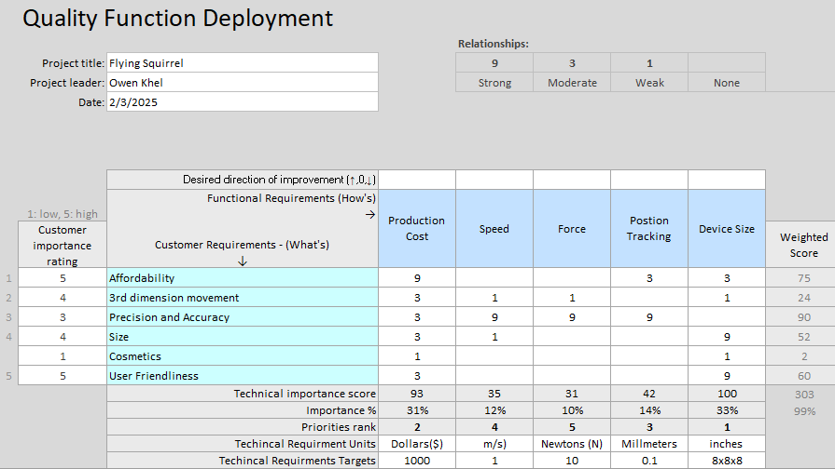
QFD
Important Benchmarks
A production cost of 1000$
Capable of 10 Newtons of force
A device size concentrate of 8x8x8 inches
Accurate position tracking with a tolerance of 0.1 mm
Table 1: QFD
Notes:
Needs to be more in-depth, as more calculations are done revisit and update this. Add more columns

Slide 7
Literature Review
Books, Chapters, and Articles
Other Resouces
Books/Chapters
Rehabilitation Robotics: Technology and Application
Atlas of Orthoses and Assistive Devices
Papers/Journals
Wrench feasibility workspace analysis and adaptive rotation algorithm of cable-driven upper limb rehabilitation robot
Control of a large redundantly actuated cable-suspended parallel robot
String-man: A new wire robot for gait rehabilitation
Online Articles
Rehabilitation robot,” Rehabilitation Robot - an overview
Garrett Brown’s skycam history
Fish Line Strength Charts
“How skycam works,”
Notes:
As we move forward keep track of these. If we need more add them and if we don’t use get rid of.

Slide 8
Literature Review
Books, Chapters, and Articles
Other Resouces
Books/Chapters
Arduino robotic projects: build awesome and complex robots with the power of Arduino
Raspberry Pi 3 cookbook for Python programmers : unleash the potential of Raspberry Pi 3 with over 100 recipes
Online/Conferences/Gov.
Robot-assisted Therapy in Stroke Rehabilitation
A novel cable-driven robotic training improves locomotor function in individuals post-stroke
How to Use Raspberry Pi and Arduino Together
Articles
Modeling Cable-Driven Robot With Hysteresis and Cable-Pulley Network Friction
Permanent magnet DC motor control by using arduino and motor drive module BTS7960
Design and Evaluation of a Bowden-Cable-Based Remote Actuation System for Wearable Robotics

Slide 9
Literature Review
Books, Chapters, and Articles
Other Resouces
Books/Chapters
Encyclopedia of Smart Materials
Chapter 5 - Robotics and rehabilitation: the role of robot-mediated therapy post stroke
Online/Conferences/Gov.
Adaptive Robot-Assisted Feeding: An Online Learning Framework for Acquiring Previously Unseen Food Items
Adaptive assistive robotics: a framework for triadic collaboration between humans and robots
A State-of-the-Art Review on Robots and Medical Devices Using Smart Fluids and Shape Memory Alloys
Articles
Upper Limb Robot Mediated Stroke Therapy—GENTLE/s Approach
Multi-sensor fusion for body sensor network in medical human–robot interaction scenario
Development of an Integrated Haptic Sensor System for Multimodal Human–Computer Interaction Using Ultrasonic Array and Cable Robot

Slide 10
Literature Review
Books, Chapters, and Articles
Other Resources
Books/Chapters
Chapter 6 - Robotics in Rehabilitation Medicine: Prosthetics, Exoskeletons, All Else in Rehabilitation Medicine
Chapter 3 – Sensors and Transducers
Online Sources
Human Body Mass Distribution
Understanding Force Sensors: How They Work and Measure Force
Accurate Tracking: A Look at Position and Distance Sensors
Articles
Forces and Moments Generated by the Human Arm: Variability and Control
Force Control and Degree of Motor Impairments in Chronic Stroke
A Low-Dimensional Representation of Arm Movements and Hand Grip Forces in Post-Stroke Individuals

Slide 11
Literature Review
Books, Chapters, and Articles
Other Resources
Books/Chapters
Raspberry Pi Robotic Projects
Hands-on robotics programming with C++ : leverage raspberry pi 3 and C++ libraries to build intelligent robotics applications.
Articles
ToF 3D Vision Algorithms in C++ for Robotic Applications
Gesture Control Robot with Arduino
Path Following System for Cooperative Mobile Robots
Online Sources
Wire Robots Part I: Kinematics, Analysis &amp; Design
Robot dynamics and control
Controlling Tensegrity Robots through Evolution

Slide 12
Mathematical Modeling
Wire Tension
Engineering Tools
Explanation
Though with our robot design it won’t be enduring it max stress, we still test it at what a worst-case scenario could be.
That would be if all ten newtons were acting on a single wire.
T=10N
In addition, we added a factor of safety of nf=1.2, diameter of the selected wire being .022mm
Equation
Stress = (F*nf) / A = (T*nf) * A
A=( ( pi ) d ^ 2 ) / 4= 3.801*10^-6
Stress = 3,157 Kilopascal
Engineering Toolbox
Shigley's Mechanical Engineering Design, 11th Edition
Fish Line Strength Charts
Notes:
Add what the assumptions are and how we are going to utilize and validate, validate, validate. Accuracy of the numbers.

Slide 13
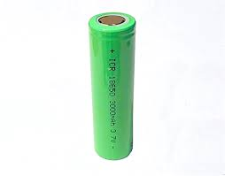
Mathematical Modeling
Total Battery Capacity Required
Engineering Tools
Components
4 motors at 2-amp draw
4 motor controllers at 0.25-amp draw
1 Raspberry Pi at 0.35-amp draw
1 Arduino at 0.1-amp draw
1 Display at 0.5-amp draw
Position sensors and inverters negligible amp draw
Equations
Combined amperes = ∑A
(4 • 2) + (4 • 0.25) + 0.35 + 0.1 + 0.5 = 9.95 amperes
Assumed average efficiency = η = 0.85
Total amperes required = Atot = ∑A/η = 9.95 / 0.85 = 11.7 amperes
Required run time = t = 0.5 hours
Minimum amp-hours required = Atot • t =11.7 • 0.5 = 5.85 A-h
MakerBot Print (MakerBot's slicing software)
Engineering Toolbox: Material Properties
Fusion360 or Onshape
Python and C++
Image 4: 18650 Battery
13

Slide 14
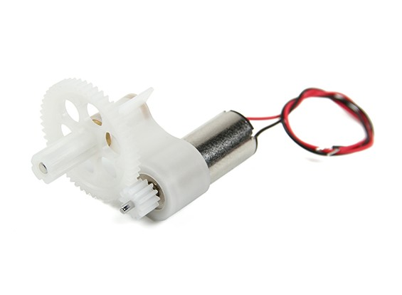
Mathematical Modeling
T – Torque
r – Radius
F – Force
N – Number of gear teeth
Torque
Engineering Tools
Torque Equations:
T = f*Fsinϴ (F*r)
T_{out} = T_{in}*(N_{out}/N_{in})
Importance:
Velocity control
Motor/Gearing selection
Working in boundary conditions
Example:
T_{out} = 10 * (20 / 10)
T_{out} = 20 (F*r)
20 = r * 10 sin 90
r = 10 (r)
Onshape, Fusion360, Sketchup, Solidworks
Engineering toolbox
Material properties
"Mechanical Engineering Design, 11th edition"
"Applied Mechanics Dynamics"

Slide 15
Mathematical Modeling
Necessary Lifting Strength
Quantities:
M= Total body mass
L= Total arm reach (Shoulder to knuckles)
g= Acceleration due to gravity (9.81m/s²)
P_{hm}, P_{fm}, P_{am}= Percentages of body mass occupied by the hand, forearm, and arm
P_{hl}, P_{fl}, P_{al}= Percentages of reach occupied by the same
F= Net upward force produced by FS
Equation:
F= M[P_{hm}g(1-0.5P_{hl})+P_{fm}g(0.5P_{fl}+P_{al})+P_{am}g(0.5P_{al})]
Rough approximation for M= 70kg and L= 0.6096m
F= 14.5N
Engineering Tools:
ANSYS
Matlab

Slide 16
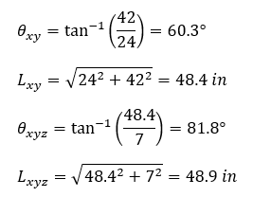
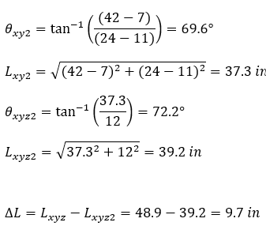
Mathematical Modeling
Vector Analysis for Motion and Motion Tracking
Engineering Tools:
Example Equation:
Wire 1 starting position: (0, 0, 7) (inches)
Wire 1 Anchor position: (24, 42, 0) (inches)
MATLAB/Python for Vector Tracking and Modelling and Fusion360 for parametric modelling
If Wire 1 is supposed to then end up at (11, 7, 12) (inches):
Then, knowing the diameter of the winch, the robot would calculate how many rotations it would need to move the wire 9.7 inches.
The elevation mechanism is separate, but the change in elevation would affect the change in the length of the wire.

Slide 17
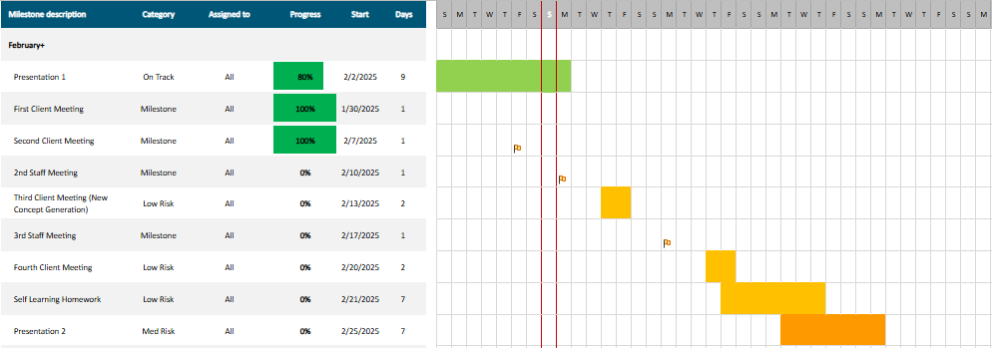
Project Schedule
Most salient tasks are meetings with the client and concept generation
Initial phase of concept generation is complete
Next concepts to be completed before third weekly client meeting
No high level risk tasks
PHOTO
Table 2: Gantt Chart for February
Notes:
Wants to see all the different tasks throughout the whole semester, should like up with client requests. Include direct deliverables that client wants.

Slide 18
Budget & Expenses
 | Current Expenses | Anticipated Expenses
Project Budget | +$3,750 | +$3,750
Building Materials | $0 | -3x$150 ($450)
Part Manufacturing | $0 | -3x$150 ($450)
Machinery and Electronics | $0 | -3x$400 ($1,200)
Research Material | $0 | -$100
Fundraising | $0 | +$375
Balance | $3,375 | $1,550
No expenses incurred yet
Accounts for three models with $700 production cost
Some funds set aside for manuals or trainings
Each team member will contribute at least $75 to fundraising
Table 3: Budget & Expenses

Slide 19
Conclusion & Moving Forward
Conclusion
Dr. Razavian has asked us to construct a cable-driven robot to be used as a therapy device for stroke victims.
The robot must be compact, easy to set up, affordable, and precise in its movements.
We have a budget of $3750 as well as an addition $375 that is to be fundraised by the team to construct this robot.
Moving Forward
Begin cable-driven robot concept selection and SolidWorks designing
Begin building Bill of Materials using mathematical modeling data.
Begin putting together code to power motors using sources in Lit. Review
PHOTO
Notes:
Try to trim down time for presentation. Make formatting more consistent. Practice the presentation more.

Slide 20
References
[1] R. Colombo and V. Sanguineti, Rehabilitation Robotics: Technology and Application. London: Academic Press, 2018.
[2] J. B. Webster and D. Murphy, Atlas of Orthoses and Assistive Devices. Philadelphia, PA: Elsevier, 2019.
[3] Y. Li, A. Song, J. Lai, H. Li, and K. Shi, “Wrench feasibility workspace analysis and adaptive rotation algorithm of cable-driven upper limb rehabilitation robot,” Proceedings of the 2023 9th International Conference on Robotics and Artificial Intelligence, pp. 32–37, Nov. 2023. doi:10.1145/3637843.3637844
[4] J. Lamaury and M. Gouttefarde, “Control of a large redundantly actuated cable-suspended parallel robot,” Login - CAS – central authentication service, https://doi-org.libproxy.nau.edu/10.1109/ICRA.2013.6631240 (accessed May 9, 2025).
[5] D. Surdilovic and R. Bernhardt, “String-man: A new wire robot for gait rehabilitation,” IEEE International Conference on Robotics and Automation, 2004. Proceedings. ICRA ’04. 2004, Apr. 2004. doi:10.1109/robot.2004.1308122
[6] E. Wong, “Garrett Brown’s skycam history,” Futurism, https://vocal.media/futurism/garrett-brown-s-skycam-history (accessed Feb. 9, 2025).
[7] N. Chandler, “How skycam works,” HowStuffWorks, https://electronics.howstuffworks.com/cameras-photography/digital/skycam.htm (accessed Feb. 9, 2025).
[8] “Rehabilitation robot,” Rehabilitation Robot - an overview | ScienceDirect Topics, https://www.sciencedirect.com/topics/nursing-and-health-professions/rehabilitation-robot (accessed Feb. 9, 2025).
[9] R. Grimmett, Arduino Robotic Projects: Build Awesome and Complex Robots with the Power of Arduino. Birmingham, England: Packt Publishing, 2014.
[10] T. Cox, Raspberry Pi 3 Cookbook for Python Programmers: Unleash the Potential of Raspberry Pi 3 with over 100 Recipes. Birmingham, UK: Packt Publishing, 2018.
[11] M. Miyasaka et al., “Modeling cable-driven robot with hysteresis and cable–pulley network friction,” IEEE/ASME Transactions on Mechatronics, vol. 25, no. 2, pp. 1095–1104, Apr. 2020. doi:10.1109/tmech.2020.2973428
[12] S. Syukriyadin, S. Syahrizal, G. Mansur, and H. P. Ramadhan, “Permanent magnet DC motor control by using Arduino and Motor Drive Module BTS7960,” IOP Conference Series: Materials Science and Engineering, vol. 352, p. 012023, May 2018. doi:10.1088/1757-899x/352/1/012023
[13] U. A. Hofmann, T. Butzer, O. Lambercy, and R. Gassert, “Design and evaluation of a Bowden-cable-based remote actuation system for wearable robotics,” IEEE Robotics and Automation Letters, vol. 3, no. 3, pp. 2101–2108, Jul. 2018. doi:10.1109/lra.2018.2809625
[14] W. H. Chang and Y.-H. Kim, “Robot-assisted therapy in stroke rehabilitation,” Journal of stroke, https://pmc.ncbi.nlm.nih.gov/articles/PMC3859002/ (accessed Feb. 8, 2025).
[15] M. Wu et al., “A novel cable-driven robotic training improves locomotor function in individuals post-stroke,” Annual International Conference of the IEEE Engineering in Medicine and Biology Society. IEEE Engineering in Medicine and Biology Society. Annual International Conference, https://pmc.ncbi.nlm.nih.gov/articles/PMC4006736/ (accessed Feb. 8, 2025).
[16] L. Pounder, “How to use Raspberry Pi and Arduino together,” Tom’s Hardware, https://www.tomshardware.com/how-to/use-raspberry-pi-with-arduino (accessed Feb. 8, 2025).
PHOTO

Slide 21
References
[17] A. G. Olabi, Encyclopedia of Smart Materials. Amsterdam: Elsevier, 2022.
[18] E. K. Stokes, “Chapter 5 - Robotics and rehabilitation: the role of robot-mediated therapy post stroke,” in Enabling Technologies: Body Image and Body Function, Birmingham, UK: Packt Publishing, pp. 77–96
[19] R. Loureiro, F. Amirabdollahian, M. Topping, B. Driessen, and W. Harwin, Autonomous Robots, vol. 15, no. 1, pp. 35–51, 2003, doi: https://doi.org/10.1023/a:1024436732030.
[20]K. Lin, Y. Li, J. Sun, D. Zhou, and Q. Zhang, “Multi-sensor fusion for body sensor network in medical human–robot interaction scenario,” Information Fusion, vol. 57, pp. 15–26, May 2020, doi: https://doi.org/10.1016/j.inffus.2019.11.001.
[21] L. Fan, A. Song, and H. Zhang, “Development of an Integrated Haptic Sensor System for Multimodal Human–Computer Interaction Using Ultrasonic Array and Cable Robot,” IEEE Sensors Journal, vol. 22, no. 5, pp. 4634–4643, Mar. 2022, doi: https://doi.org/10.1109/jsen.2022.3144888.
[22] E. Gordon, X. Meng, T. Bhattacharjee, M. Barnes, and S. Srinivasa, “Adaptive Robot-Assisted Feeding: An Online Learning Framework for Acquiring Previously Unseen Food Items.” Accessed: Feb. 06, 2025. [Online]. Available: https://personalrobotics.cs.washington.edu/publications/gordon2020adaptive.pdf
[23] D. F. N. Gordon, A. Christou, T. Stouraitis, M. Gienger, and S. Vijayakumar, “Adaptive assistive robotics: a framework for triadic collaboration between humans and robots,” Royal Society Open Science, vol. 10, no. 6, Jun. 2023, doi: https://doi.org/10.1098/rsos.221617.
[24] J. Sohn, G.-W. Kim, and S.-B. Choi, “A State-of-the-Art Review on Robots and Medical Devices Using Smart Fluids and Shape Memory Alloys,” Applied Sciences, vol. 8, no. 10, p. 1928, Oct. 2018, doi: https://doi.org/10.3390/app8101928.
[25] D. P. Murphy, "Robotics in Rehabilitation Medicine: Prosthetics, Exoskeletons, All Else in Rehabilitation Medicine," in Robotics in Physical Medicine and Rehabilitation, First edition. Philadelphia, PA: Elsevier, 2025.
[26] J. Segil, "Sensors and Transducers," in Handbook of biomechatronics. London, United Kingdom: Academic Press, an imprint of Elsevier, 2019.
[27] Y. Xu, A. V. Terekhov, M. L. Latash, and V. M. Zatsiorsky, “Forces and moments generated by the human arm: variability and control,” Experimental brain research, vol. 223, no. 2, pp. 159–175, 2012, doi: 10.1007/s00221-012-3235-0.
[28] N. Lodha, S. K. Naik, S. A. Coombes, and J. H. Cauraugh, “Force control and degree of motor impairments in chronic stroke,” Clinical neurophysiology, vol. 121, no. 11, pp. 1952–1961, 2010, doi: 10.1016/j.clinph.2010.04.005.
[29] C. M. Kanzler et al., “A low-dimensional representation of arm movements and hand grip forces in post-stroke individuals,” Scientific reports, vol. 12, no. 1, pp. 7601–7601, 2022, doi: 10.1038/s41598-022-11806-4.
PHOTO

Slide 22
References
[30] D. Matos. "Human Body Mass Distribution." ResearchGate. https://www.researchgate.net/figure/Human-body-mass-distribution_tbl2_303379664 (accessed February 9, 2025).
[31] I. Patsiaouras. "Understanding Force Sensors: How They Work and Measure Force." BOTA Systems. https://www.botasys.com/post/force-sensors (accessed February 9, 2025).
[32] A. Armenta. "Accurate Tracking: A Look at Position and Distance Sensors." Control.com. https://control.com/technical-articles/accurate-tracking-a-look-at-position-and-distance-sensors/ (accessed February 9, 2025).
[33]R. Grimmett, Raspberry Pi Robotic Projects. Packt Publishing Ltd, 2016.
[34]D. Tavasalkar, Hands-on robotics programming with C++ : leverage raspberry pi 3 and c++ libraries to build intelligent robotics applications. Birmingham, UK: Packt Publishing Ltd, 2019.
[35]“ToF 3D Vision Algorithms in C++ for Robotic Applications - ProQuest,” Proquest.com, 2022. https://www.proquest.com/docview/2696854523?pq-origsite=primo&sourcetype=Dissertations%20&%20Theses (accessed Feb. 07, 2025).
[36]C. P. Kumar and Salumari Madhu, “Gesture Control Robot with Arduino,” IOP Conference Series Materials Science and Engineering, vol. 455, pp. 012106–012106, Dec. 2018, doi: https://doi.org/10.1088/1757-899x/455/1/012106.
‌ [37]I. Dinulescu, D. Popescu, M. Nitulescu, and A. Predescu, “Path Following System for Cooperative Mobile Robots,” Solid State Phenomena, vol. 166–167, pp. 161–166, Sep. 2010, doi: https://doi.org/10.4028/www.scientific.net/ssp.166-167.161.
[38]T. Bruckmann, L. Mikelsons, T. Brandt, M. Hiller, and D. Schramm, ‘Wire Robots Part I: Kinematics, Analysis &amp; Design’, Parallel Manipulators, New Developments. I-Tech Education and Publishing, Apr. 01, 2008. doi: 10.5772/5365.
https://www.intechopen.com/chapters/763
[39]M. W. Spong and M Vidyasagar, Robot dynamics and control. New York: Wiley, 2004.
‌ [40]A. Iscen, A. Agogino, A. Agogino@nasa, V. Gov, Sunspiral, and K. Tumer, “Controlling Tensegrity Robots through Evolution,” 2013. Accessed: Feb. 10, 2025. [Online]. Available: https://ntrs.nasa.gov/api/citations/20160000329/downloads/20160000329.pdf
PHOTO

Slide 23
Thank you!

